Slide 1
CH 4
Recursion

Slide 2
Recursion - Introduction
Process by which a function calls itself repeatedly, until some specified condition has been satisfied.
Mostly used for repetitive computations in which each action is stated in terms of a previous result.
For solving a problem using recursion, 2 conditions must be satisfied:
First, the problem must be written in a recursive form. [based on previous result]
Second the problem statement must include a stopping condition.
Recursion is based on Divide and conquer strategy.

Slide 3
Advantages
The code may be much easier to write
Some problems are inherently recursive in nature.
Disadvantages
Recursive functions are normally slower than iterative functions.
May require a lot of memory to hold intermediate result on the stack.
Difficult to formulate solution

Slide 4
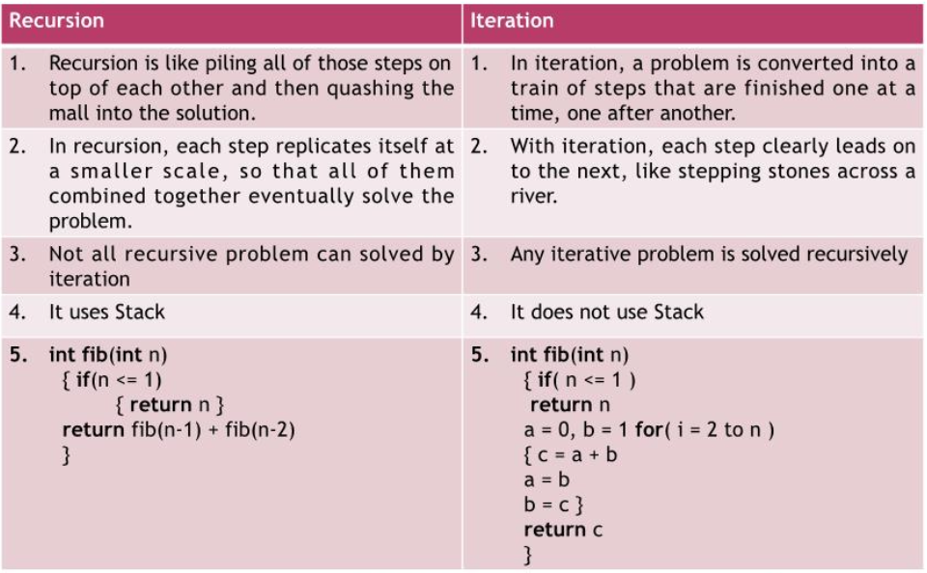
Recursion vs Iteration

Slide 5
Tail Recursion
A special form of recursion where the last operation of a function is a recursive call. The recursion may be optimized away by executing the call in the current stack frame and returning its result rather than creating a new stack frame.
The tail recursive functions are considered better than non tail recursive functions as tail-recursion can be optimized by compiler.
Compilers usually execute recursive procedures by using a stack.
This stack consists of all the pertinent information, including the parameter values, for each recursive call.
When a procedure is called, its information is pushed onto a stack, and when the function terminates, the information is popped out of the stack. Thus for the non-tail-recursive functions, the stack depth (maximum amount of stack space used at any time during compilation) is more.

Slide 6
Tail Recursion[2]
The idea used by compilers to optimize tail-recursive functions is simple, since the recursive call is the last statement, there is nothing left to do in the current function, so saving the current function's stack frame is of no use.
We can use factorial using recursion, but the function is not tail recursive.
Long fact(int n){
if(n<=1)
Return 1;
Return n*fact(n-1);
}

Slide 7
Tail Recursion[3]
Long fact(int n){
if(n<=1)
Return 1;
Return n*fact(n-1);
}
We can make it tail recursive by adding some additional parameters.
Long fact(long n,long a){
if(n==0)
Return a;
Return fact(n-1,a*n);

Slide 8
Recursively defined function
A function is said to be recursively defined if the function refers to itself such that:
There are certain arguments, called base values, for which the function does not refer to itself.
Each time the function refers to itself, the argument of the function must be closer to a base value.

Slide 9

Recursively defined function - example [1] - Factorial
The factorial of a number is the product of all the integers from 1 to that number. [ex: 5! = 1*2*3*4*5 = 120 ]
Factorial is not defined for negative integers and the factorial of zero is 1.
Recursive definition of factorial function f:
f(0) = 1, f(1) = 1 => Base case(s):- this doesn’t require recursion.
f(n) = n*f(n-1) => Recursive case:- the function calls itself, with simpler instance.

Slide 10
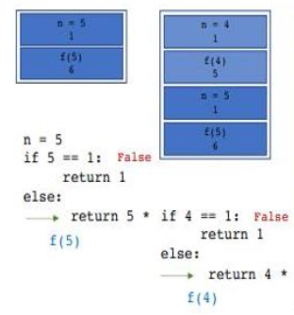
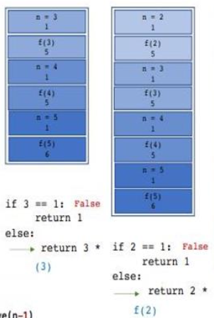
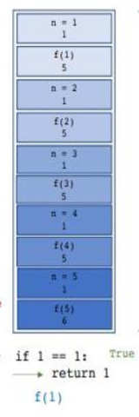
Recursively defined function - example [1] - Factorial
factorial(5)

Slide 11
Recursively defined function - ex[2] - Fibonacci Number
Fibonacci numbers are the numbers appearing in the following integer sequence: 0,1,1,2,3,5,8,13,21,34,55,89,144, ……………..
This can be defined mathematically as: F_{n} = F_{n-1} + F_{n-2} with F₀=0 and F₁=1
Fibonacci as recursive function: def fibonacci(n): If n==0: Return 0 Else if n==1: Return 1 Else: Return fibonacci(n-1) + fibonacci(n-2)

Slide 12
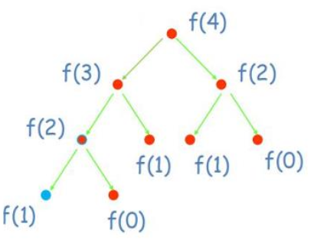
Recursively defined function - ex[2] - Fibonacci Number
fibonacci(4):

Slide 13
Recursively defined function - ex[3] - GCD
GCD or HCF of two numbers is the largest number that divides both of them.
Ex: GCD of 63 & 42: The factors of 63 are (7,3) ie: 63 = 7 * 3 * 3 The factors of 42 are (7,3,2) ie: 42 = 7 * 3 * 2 So the GCD of 63 and 42 is 21 [7*3=21]
Find the GCD of 192, 64

Slide 14
Recursively defined function - ex[3] - GCD
Recursive definition of GCD: Int gcd(int a, int b){ if(a==0||b==0) Return 0; Else if(a == b) Return a; Else if(a > b) Return gcd(a-b, b); Else Return gcd(a, b-a);

Slide 15
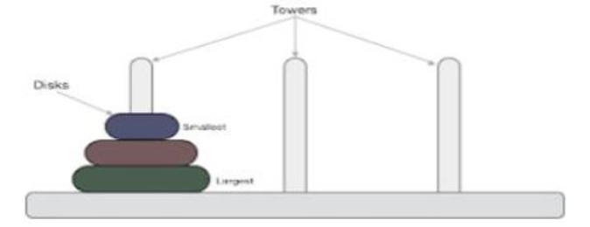
Recursively defined function - ex[3] - Tower of Hanoi
Tower of Hanoi is a classical mathematical puzzle which consists of three tower pegs and more than one rings.
It consists of three rods and a number of disks of different sizes, which can slide onto any rod. The puzzle starts with the disks in a stack in ascending order of size on one rod, the smallest at the top, this making a conical shape.

Slide 16
Recursively defined function - ex[3] - Tower of Hanoi[2]
The objective of the puzzle is to move the entire stack to the last rod, obeying the following rules:
Only one disk can be moved at a time.
Each move consists of taking the upper disk from one of the stacks and placing it on top of another stack or on an empty rod.
No larger disk may be placed on top of a smaller disk.

Slide 17
Recursively defined function - ex[3] - Tower of Hanoi[3]
Recursive Solution to TOH
Function recursiveTOH(n,s,a,d) // n=> number of disks, s=> starting pole, //a=>intermediate pole, d=> destination pole.
If n==1 then Display “move s to d” Return
recursiveTOH(n-1,s,d,a);
Display “move s to d”
recursiveTOH(n-1,a,s,d);
End function

Slide 18
Recursively defined function - ex[3] - Tower of Hanoi[4]
Case 1: For even number of disks:
Make the legal move between pegs A & B (in either direction)
Make the legal move between pegs A & C (in either direction)
Make the legal move between pegs B & C (in either direction)
Repeat until complete
Case 2: For an odd number of disks:
Make the legal move between pegs A & C (in either direction)
Make the legal move between pegs A & B (in either direction)
Make the legal move between pegs B & C (in either direction)
Repeat until complete
In either case, a total of 2^{n} -1 moves are required.

Slide 19
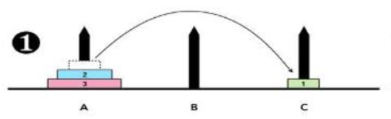
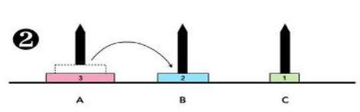
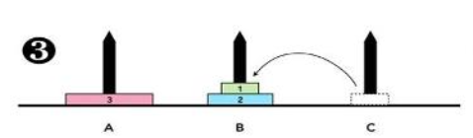
Recursively defined function - ex[3] - Tower of Hanoi[5]
Example:

Slide 20
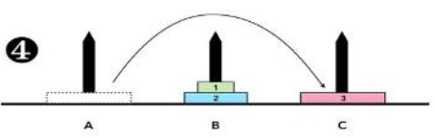
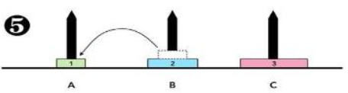
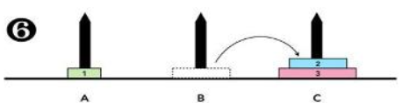
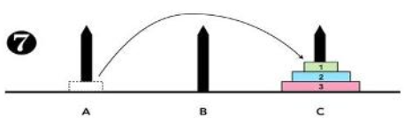
Recursively defined function - ex[3] - Tower of Hanoi[6]
Example:

Slide 21
Applications of Recursion
Sorting of data
Solving problems based on tree structure
Calculating mathematical series and sequences
Drawing and detecting fractals and graphical objects

Slide 22
Finding efficiency of a recurrence relation
Steps to formulate the recurrence relation
Find the input size of the problem.
Find the number of subproblems and its input size
Write recurrence relation based on subproblems
Solve the recurrence relation.

